Slide 1



Task and Strategic Determinants of the Irrelevant Sound Effect
Daniel J. Zweben, Jamielyn R. Samper, and Jason M. Chein
Temple University
Psychonomic Society Annual Meeting 2025

Slide 2

What causes the irrelevant sound effect?​
1. How and why do irrelevant background sounds disrupt our performance on working memory tasks?
2. What determines when this disruption occurs?

Slide 3

Overview
Introduction: The ISE and working memory.
Theory: Consider key theoretical ideas about why the ISE occurs.
Study 1: Broad examination across multiple tasks, sound types, and self-reported strategies.
Study 2: Focused test of the ISE using 3 tasks and traditional sound types.
Evaluation: Integrate findings to evaluate how well current explanations account for ISE variability.

Slide 4
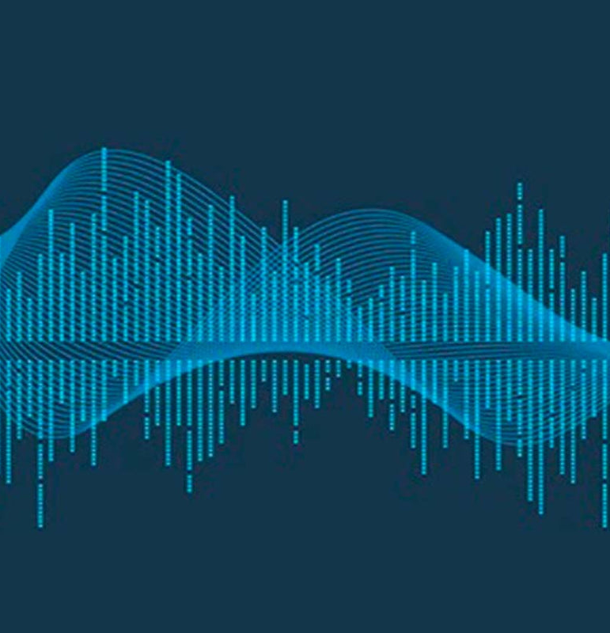
What is the irrelevant sound effect (ISE)?
The ISE refers to the disruption of information processing and working memory performance caused by background sounds that are irrelevant to the task (Colle & Welsh, 1976; Salamé & Baddeley, 1982).
First demonstrated and mostly replicated in serial recall paradigms, where irrelevant speech reliably disrupts ordered short-term memory (Colle & Welsh, 1976; Salamé & Baddeley, 1982).

Slide 5

Encoding
Remember These Items In order
Serial-Recall
Silence
222222
295271
Shoe
Door
Boat
Foot
Cat
Water
Desk
Shoe (1)
Door (2)
Water (6)
Cat (5)
Desk (7)

Slide 6
Why does the irrelevant sound effect matter?

Slide 7
Why does the irrelevant sound effect matter?
Everyday relevance: We live in environments full of sound: conversation, traffic, notifications. These sounds reliably disrupt core cognitive functions like remembering and sequencing information (Colle & Welsh, 1976; Salamé & Baddeley, 1982).
A window into working memory: The ISE is a benchmark phenomenon that any theory of working memory must be able to explain (Oberauer et al., 2018). Understanding when background noise impairs performance is one way cognitive psychologists test fundamental assumptions about WM architecture.

Slide 8

ISE Frameworks: Competing Accounts
ISE has been studied occasionally in different contexts and conditions, some of which produce an ISE while others do not.
This variable pattern of findings has informed a lasting debate over the precise mechanisms that underlie the ISE (Bell, Röer, Lang, & Buchner, 2019a; Bell, Röer, Lang, & Buchner, 2019b; Hughes, 2014; Jones & Tremblay, 2000; Jones et al., 1992; Lange, 2005; Le Compte, 1994; Marsh, Hughes, & Jones, 2009).
The competing perspectives surrounding the origins of the ISE are also sometimes grounded in disparate views of the basic mental machinery of working memory (WM).

Slide 9
Attentional Disruption
Order Interference
Working Memory
Working Memory
Serial Order:
Maintenance Process
A → B → C → D
↓
Auditory System
Attention Captured!
(Automatic encoding)
Irrelevant Sounds
1
→
2
→
3
♪ ♫ ♪ ♫ ♪
Changing Sound Order
Sounds capture attention away from maintenance, interrupting WM processes
Auditory system automatically encodes changing order of sounds. This disrupts serial rehearsal of TBR items, creating conflict with serial order maintenance in WM.
Cowan, 1995; Röer, Bell, & Buchner, 2014
Jones et al., 1992; Beaman & Jones, 1997; Hughes et al., 2005

Slide 10
Attentional Disruption
Order Interference
Auditory deviants capture attention reflexively (Schröger et al., 2000).
Irrelevant sounds can momentarily interrupt goal maintenance (Cowan, 1995; Röer et al., 2014).
Some ISE-like effects appear even in tasks that don’t strongly emphasize serial order (e.g., Stokes & Arnell, 2012).
Tasks that should eliminate the possibility of serial rehearsal still show ISEs (Samper et al., 2021; AuBuchon et al., 2020).
The ISE is biggest in serial recall tasks (Jones et al., 1992; Beaman & Jones, 1997).
It is notably reduced when the task removes or discourages ordered maintenance (Le Compte, 1994; Salamé & Baddeley, 1990).
Changing-state sounds (varied sounds) produce far more disruption than steady-state sounds (changing-state effect; Jones & Tremblay, 2000; Marsh et al., 2009b).
Working-memory capacity hasn't been found to predict the size of the ISE (Sörqvist, 2010).

Slide 11
Duplex-Mechanism Account
Hughes, 2014; Hughes et al., 2013; Hughes, Vachon, & Jones, 2005; Hughes & Marsh, 2020
1. Order-Based Interference
2. Attentional Capture
The duplex mechanism account combines elements of attention capture and order interference
Importantly, this account maintains that the changing state effect is exclusively associated with order interference processes
We will challenge this position.

Slide 12


Research Questions
1. Which irrelevant sounds disrupt performance?
Changing-State (CS), Steady-State (SS), and Quiet conditions.
2. Is the irrelevant sound effect different in ordered vs. non-ordered tasks?
We tested whether both serial order and non-serial order tasks produce an ISE.
3. Does strategy matter?
We tested if the ISE magnitude differs for Rehearsers vs. Non-Rehearsers

Slide 13


Study 1: Procedure & Tasks
Participants & Strategy Instruction
Tasks Presented in This Talk (4 of 8)
Participants (N=105): college students (ages 18–35).
Tasks: Eight short term and working memory tasks
- Word recall tasks used open stimulus pool for TBR items.
- Trials: 3 practice + 9 experimental per task.
Conditions: CS, SS, and Quiet.
Ordered Tasks
Delayed Serial Recall
N-Back: 3-back continuous updating (Closed Pool)
Strategy Lesson: Guided lesson on nine common memory strategies (e.g., rehearsal, imagery, checklist).
Non-Ordered Tasks
Missing Item (Closed Pool)
Strategy Reporting: Participants chose and practiced a strategy before each task and reported consistency afterward.
Delayed Free Recall (Open Pool)

Slide 14
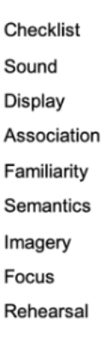
Tasks
Strategy Selection
Silence
Steady Sound (SS)
German
(CS)
Other Strategy
Delayed-Serial-Recall
Delayed-Free-Recall
Missing Item
N Back
Rehearsal

Slide 15

Study 1: Sound and Task effects
Omnibus RM-ANOVA (Sound X Task)
Significant main effect of sound condition (F(2,114) = 12.18, p < .001)
CS vs Quiet: t(57) = -4.72, p <.001
SS vs Quiet: t(57) = -2.39, p = .020
CS vs SS (Changing-State effect): t(57) = -2.68, p = .010
No Task X sound interaction (p = .263)
The changing-state effect persisted for both ordered and non-ordered task demands.

Slide 16
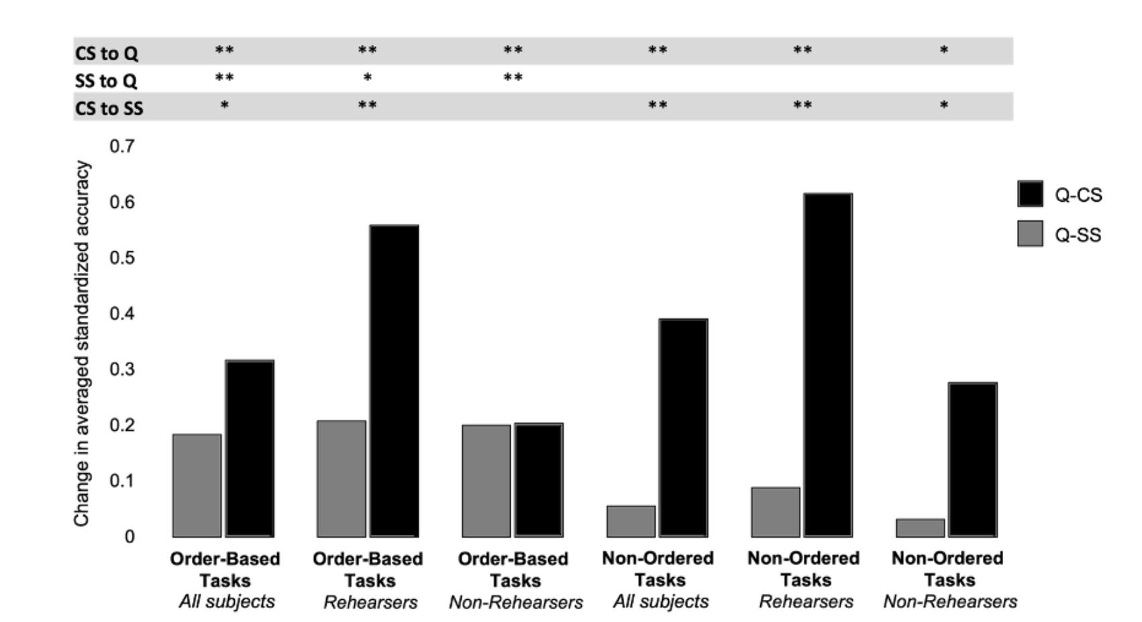
Study 1: Strategy Analysis
No overall sound × strategy group interaction: There was no main effect of strategy on performance, and strategy group did not moderate the ISE.
Rehearsers and Non-Rehearsers both showed a strong ISE: Consistent CS and SS effects on both ordered and non-ordered tasks, with SS impairing performance but to a smaller extent.
Changing-state effects (CS > SS) were more pronounced in rehearsers, but were also significant in non-rehearsers (even for non-ordered tasks)

Slide 17


Study 1 Discussion: Evaluating the Serial Rehearsal Account
Support
Challenges
CS disrupts Ordered Tasks: All showed significant CS impairment relative to Quiet.
SS Disruption: SS sounds also disrupted ordered tasks.
Non-Rehearsal: Non-rehearsers were disrupted by both CS and SS (Theory predicts immunity).
Changing-State Effect: A clear CS > SS pattern emerged on ordered tasks.
Non-Ordered Tasks: CS disruption occurred on non-ordered tasks.
Strategy: Rehearsers showed a relatively larger CS > SS difference on ordered tasks.

Slide 18
Study 1: Limitations
Study 2
Used small number of trials per task (3 per sound condition) .
Tested fewer tasks to increase trials per task (6 per sound condition): Serial Recall, Free call, Item recognition.
Used non-traditional CS background sounds.
Used repeating vs. changing spoken digits.
Used open TBR word pool.
Used a closed word pool for each task.

Slide 19
Study 2: Procedure & Tasks
Participants & Strategy Instruction
Participants (N=44): college students (ages 18–30).
Tasks: Three short term and working memory tasks
- Word recall tasks used closed stimulus pool for TBR items.
- Trials: 3 practice + 18 experimental per task.
Conditions: CS, SS, and Quiet.
Ordered Task
DSR: Delayed Serial Recall
Non-Ordered Tasks
DFR: Delayed Free Recall
Strategy Lesson: Guided lesson on eight common memory strategies (e.g., rehearsal, imagery).
DIR: Delayed Item Recognition
Strategy Reporting: Participants chose and practiced a strategy before each task and reported consistency afterward.

Slide 20
Study 2: Sound and Task effects
Omnibus RM-ANOVA (Sound X Task)
Significant main effect of sound condition (F(2,86) = 3.16, p < .047)
CS vs Quiet: t(43) = -2.29, p=.08
SS vs Quiet: t(43) = -1.34, p = .56
CS vs SS (Changing state effect): t(43) = -.33, p = .57
No Task X sound interaction (p = .92)

Slide 21
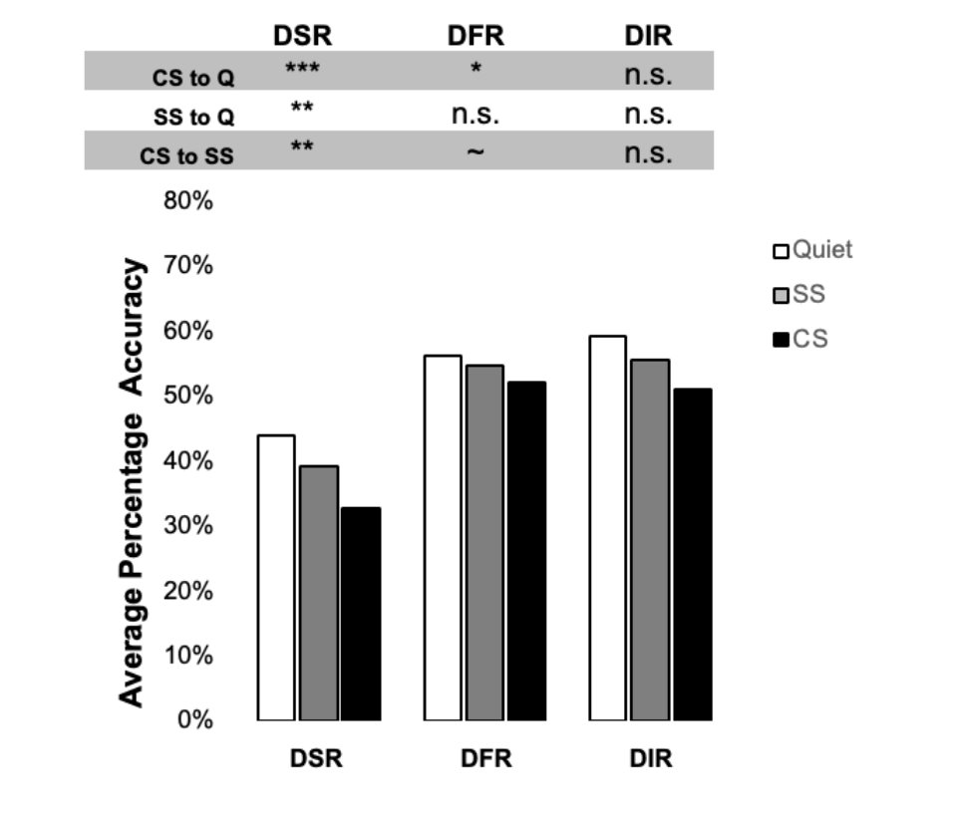
Study 2: Sound and Task effects
Delayed Serial Recall: Strong ISE across the board: both CS (p < .001) and SS (p = .007) significantly impaired performance relative to quiet, and a significant changing state effect emerged (p = .002).
Delayed Free Recall: Only CS was significantly worse than Quiet (p = .017); the changing state effect was trending (p = .056).
Delayed Item Recognition: Followed the expected Quiet > SS > CS pattern, but none of the pairwise contrasts were significant (all p > .36).

Slide 22
Study 2: Strategy Effects
Delayed Serial Recall
Contrast
CS vs Quiet
SS vs Quiet
CS vs SS
Rehearsers
t(13) = 5.37, p < .001, d = 1.40
t(13) = 2.05, p = .06, d = .55
t(13) = 3.21, p = .007, d = .86
—
—
Non-Rehearsers
t(29) = 3.50, p = .001, d = .65
t(29) = 1.97, p = .058, d = .36
t(29) = 3.04, p = .05, d = .37
—
—
No Main Effect of Strategy
No Sound × Strategy Interaction
F(1,130) = 1.14, p = .29
F(2,260) = 2.85, p = .75

Slide 23



General Discussion: Key Takeaways
1. The ISE and changing-state effect are robust, and do not depend on rehearsal.
Reliable disruption occurred even when tasks lacked an ordering requirement (DFR) and even when participants did not rehearse.
2. CS disruption is not restricted to ordered tasks.
Effects appeared in tasks with minimal order processing (e.g. Delayed Free Recall), undermining the "seriation-only" assumption.
3. Steady-State (SS) sounds can also disrupt memory.
Even repeated background sounds can disrupt performance relative to Quiet.
4. Other processes may play an important role in the changing-state effect
Vulnerability to background sounds may depend on one’s ability to select adaptive strategies and proactively maintain cognitive control over performance

Slide 24




Acknowledgements
Acknowledgements
Acknowledgements
COLLABORATORS & MENTORS
COLLABORATORS & MENTORS
COLLABORATORS & MENTORS
Dr. Jason Chein & Dr. Jamie Samper
Dr. Jason Chein & Dr. Jamie Samper
Dr. Jason Chein & Dr. Jamie Samper
All the other members of the
Temple University
Control and Adaptive Behavior Laboratory

