Slide 1

Highs and Lows of Relationship Behaviors: Constructing a Relationship-Specific Behavior Identification Form
Danny Zweben, B.A., Morgan Cope, M.A., Michael Maniaci, Ph.D.
SSSP 2023 ANNUAL CONFERENCE
November 4 - CHARLOTTE, NORTH CAROLINA

Slide 2



Overview:
Action Identification Theory
Romantic Relationship Outcomes
SSSP 2023 ANNUAL CONFERENCE

Slide 3
Overview: Action Identification Theory:
There is a wide variation in the level of abstraction at which any human behavior can identified.
Lower-level identification: details of an action
Higher-level identifications: meaning of an action
SSSP 2023 ANNUAL CONFERENCE

Slide 4

Example: Driving to work in the morning.
Meaning (High-Level)
Going to work,
making money, trying to be on time
Operating a vehicle, traveling from one place to another
Pushing pedals,
turning the wheel
Detail (Low-Level)
SSSP 2023 ANNUAL CONFERENCE

Slide 5
Behavior Identification Form (BIF): Individual Differences in Action Identification Level
The BIF gauged individual differences in preference for higher vs. lower level identifications of 25 behaviors.
High- level: securing the house
Locking a door
Lower Level:
putting a key in the lock
Vallacher & Wegner, 1989
SSSP 2023 ANNUAL CONFERENCE

Slide 6
Individual Action Identification (BIF) and Romantic Relationships
Relationships are full of many ambiguous behaviors, events, and challenges.
Higher-Level individuals may be more likely to have a coherent relationship concept into which they interpret these challenging behaviors.
Higher-Level individuals are more likely be sure of their ideas about their actions, themselves, and their opinions (Vallacher, 2009; Vallacher & Wegner, 1989).
SSSP 2023 ANNUAL CONFERENCE

Slide 7
Study 1 (n = 119)
Romantic Relationship Outcomes
  Relationship satisfaction
  Partner Concept Clarity
BIF Scores
Meaning (High-Level)
Detail (Low-Level)
SSSP 2023 ANNUAL CONFERENCE

Slide 8
Study 1: Findings
(r = .22, p <.05)
Relationship satisfaction
BIF
(r = .15, p =.10)
Partner Concept Clarity

Slide 9
Study 2: Creating a relationship-specific BIF
The BIF is domain-general. It does not adequately capture the influence of ACT ID in relationships.
Previous researchers have found it necessary to create domain specific BIFs for topics such as religion (Michaels et al., 2021) and video games (Ewell et al., 2018).

Slide 10
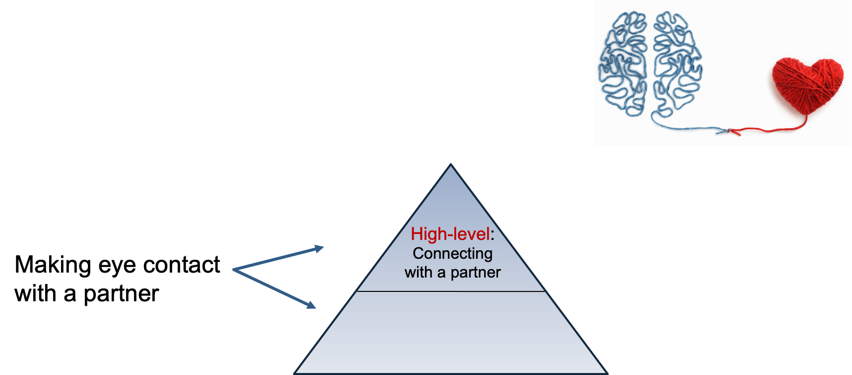
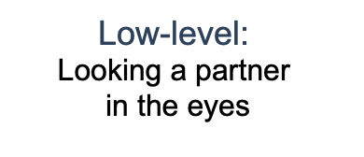
Study 2: Relationship BIF
We developed a scale to measure identification
level preference for relationship behaviors.

Slide 11
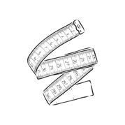
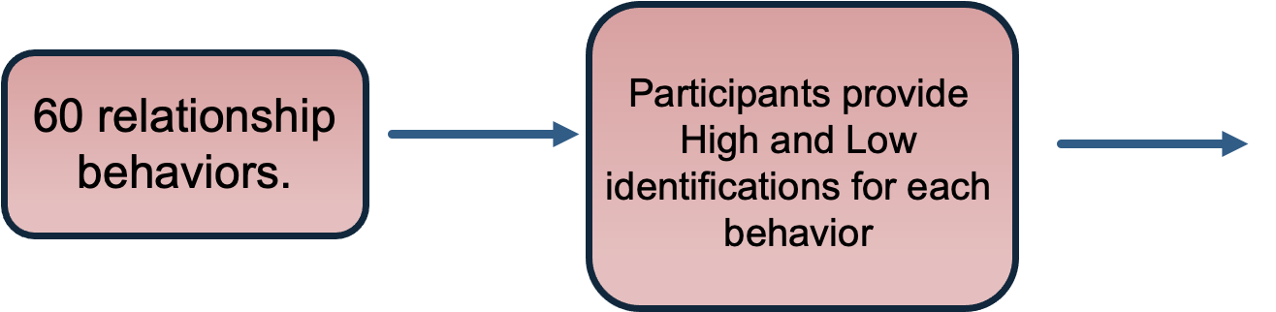

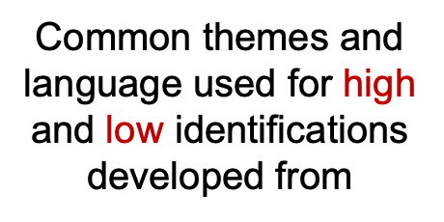
Study 2: Relationship BIF scale construction
We conducted a pilot study (n=62) to construct the relBIF

Slide 12
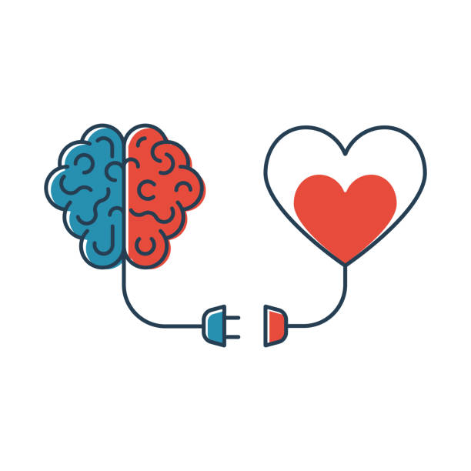
Study 3 (n = 293)
relBIF scores
BIF Scores
Romantic Relationship Outcomes
  Relationship satisfaction
  Partner Concept Clarity
  Attachment style
Meaning (Abstract)
Detail (Concrete)
SSSP 2023 ANNUAL CONFERENCE

Slide 13
Study 2: Standard BIF Findings
Relationship Satisfaction
BIF
(r = .08, p = .19)
Partner Concept Clarity
Anxious Attachment
(r = -.21, p <.001)
Avoidant Attachment

Slide 14
Study 2: Relationship BIF Findings
(r = .18, p < .01).
Relationship Satisfaction
relBIF
(r = .17, p < .01).
Partner Concept Clarity
Anxious Attachment
(r = -.27, p < .001 )
Avoidant Attachment

Slide 15
Findings and Discussion
The relBIF indexes discrete individual process that may influence a variety of relationship outcomes.
This can help us to better understand and treat relationship dysfunction.
SSSP 2023 ANNUAL CONFERENCE

